Slide 1


Reinforcement Learning
Reward Based Machine Learning
CC-BY 4.0

Slide 2
What is RL?
Machine Learning through trial and error

Slide 3
Reinforcement Learning
RL is branch of Machine Learning where a system makes decisions based on a system of rewards
The system tries to balance unexplored territory vs. its current knowledge
Different than other Machine Learning techniques

Slide 4
RL in RL
Solving complex problems through Gaming (Google’s AlphaGo)
Improving traffic patterns
Robotics?

Slide 5
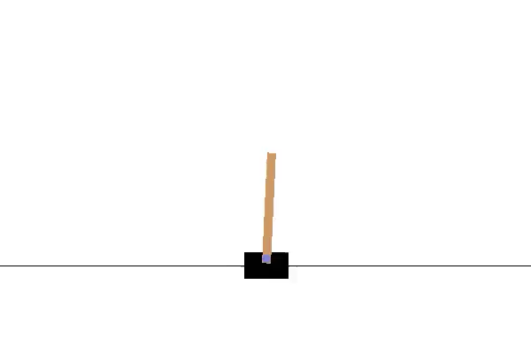
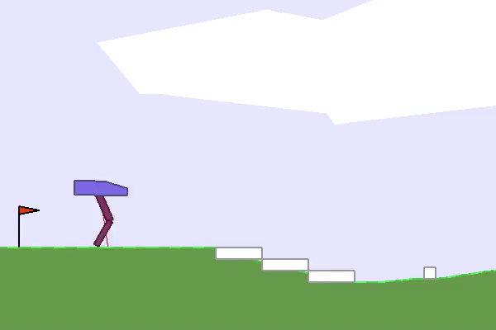
RL in Robotics
The OpenAI Gym framework allows for easy creation and training of a robot…

Slide 6
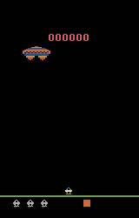
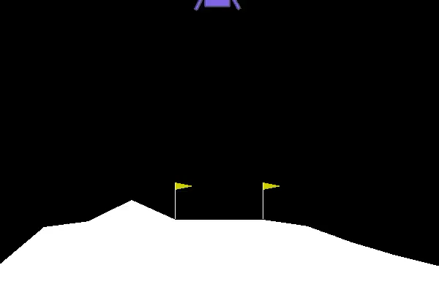
RL in Robotics
… or getting the high score on a video game

Slide 7
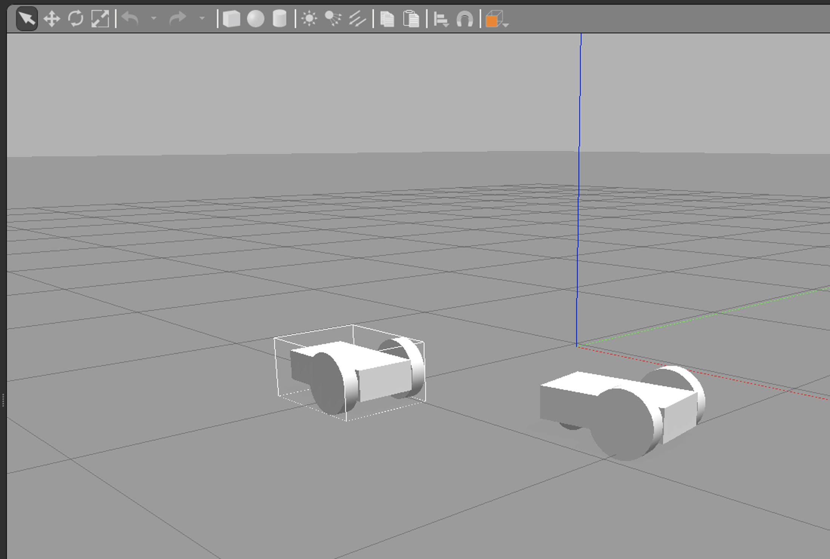
Gazebo
3D world for building robots

Slide 8
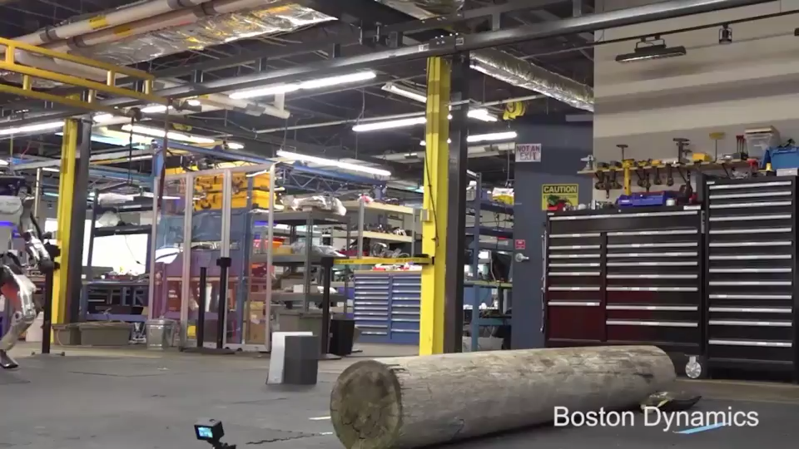
Traditional Robotics
Boston Dynamics
Algorithm based
Incremental development

Slide 9
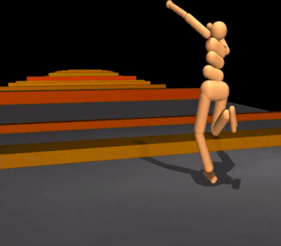
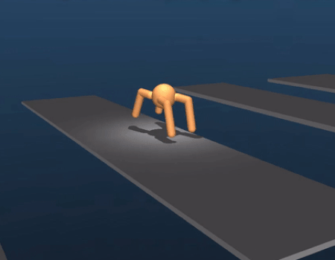
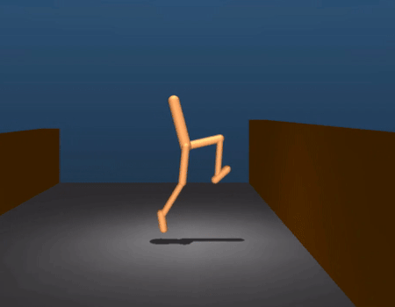
RL Robotics

Slide 10
RL Robotics in RL
How many cars would crash while learning to drive?
Could a model created virtually be applied in Real Life?
Would you feel safe riding in a car that taught itself to drive?

Slide 11
RL vs. Other Machine Learning
RL teaches itself through trial & error
Other ML techniques rely on labeled data to learn a pattern (facial recognition, object detection, speech to text)

Slide 12
References
OpenAI Gym: https://gym.openai.com
Gazebo: http://gazebosim.org
Google DeepMind: https://deepmind.com

